Slide 1

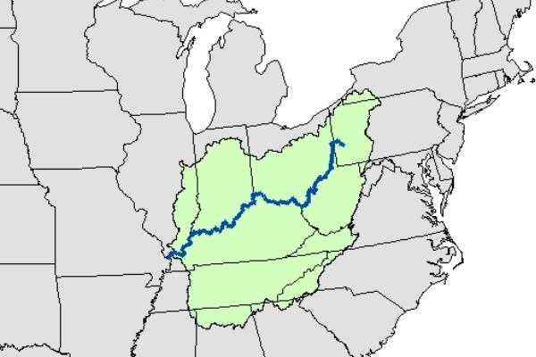
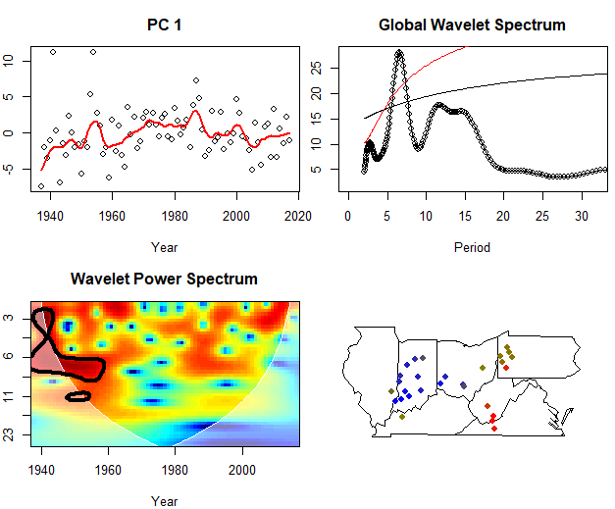
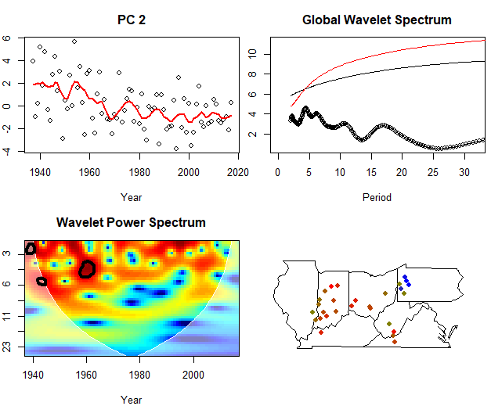
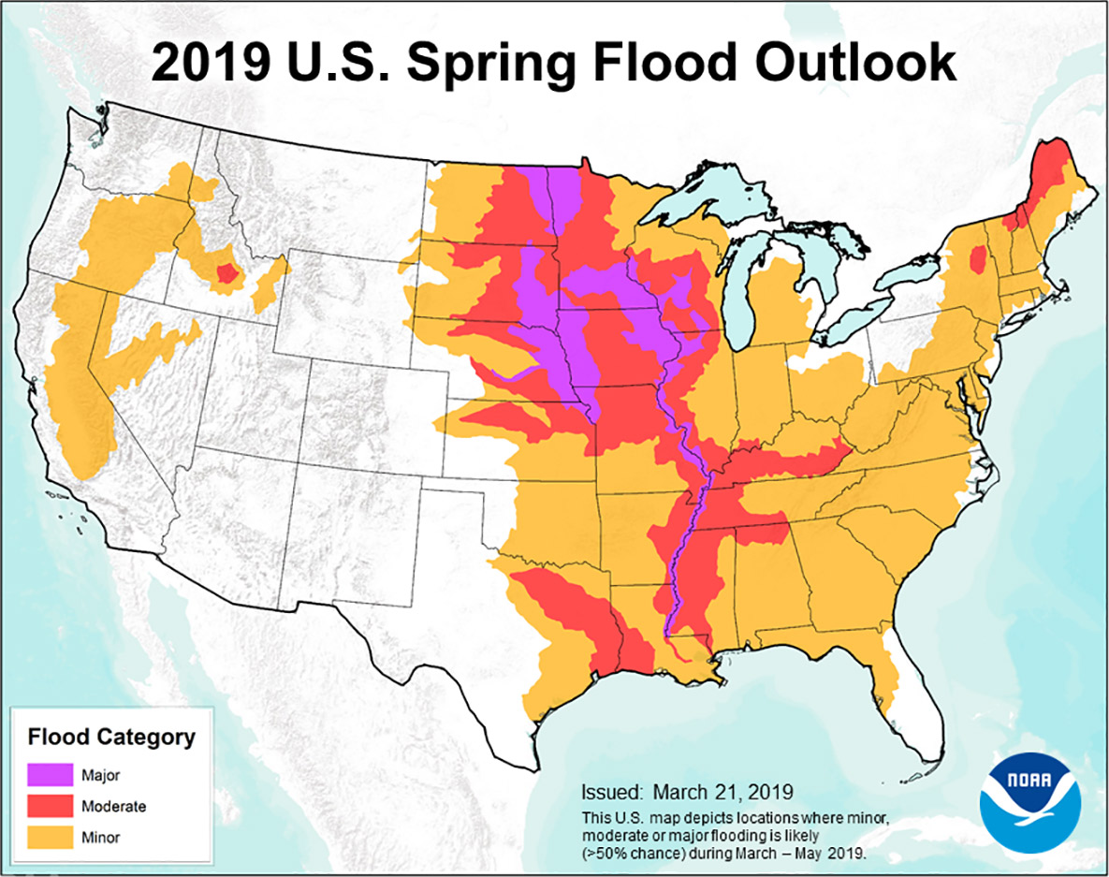
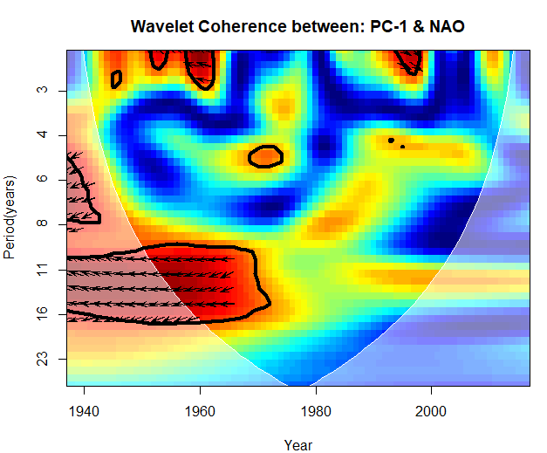
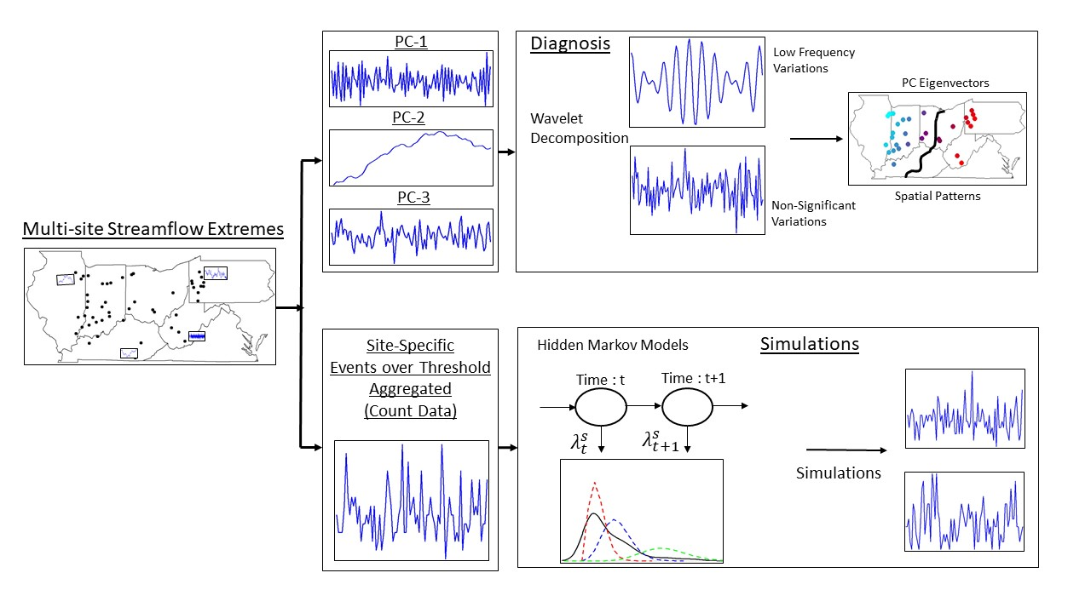
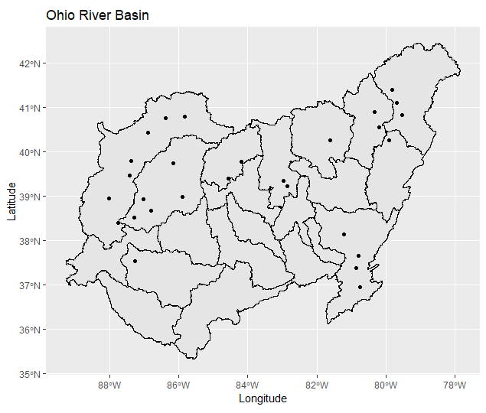
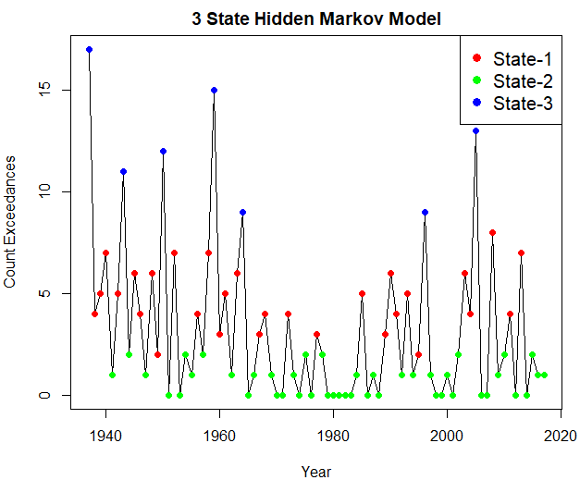
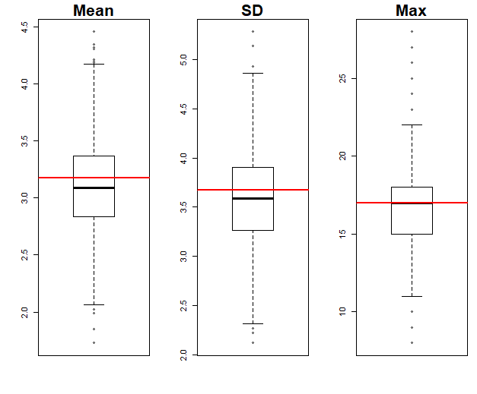
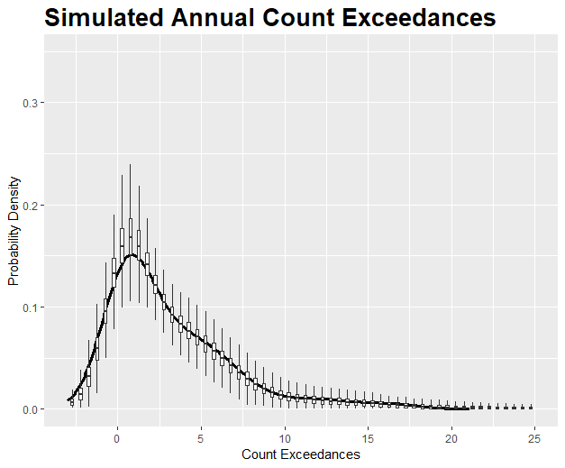
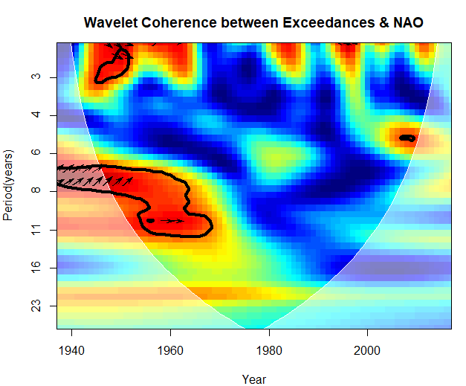
Preserving long-term variability in simulation of multisite streamflow extremes.
Yash Amonkar, James Doss-Gollin, Upmanu Lall
Department of Earth and Environmental Engineering, Columbia Water Center, Columbia University.
Abstract ID: 620477
Introduction
Floods led to more than half a million deaths worldwide from 1980-2009¹. Clustered flood occurrences across large regions are particularly catastrophic. This has been observed in the Mid-western USA since the 1930s.
Moseley (1939)²: “…the centers of greatest storminess over the United States and Canada shift in both latitude and longitude. After moving east for a number of years the location of these centers returns abruptly to a position much farther west. It may be that after ninety years the storm centers return to very nearly the same place which they had at the beginning.”
Brooks(1937)³“The conditions causing the excessive rainfall of up from 13 inches in southwestern Indiana to 12.7 in north- central Ohio in March, 1913, were almost identical with those of January, 1937”
Research Question:- 1. What can we infer as to space-time clustering of floods from historical streamflow data from the Ohio River Basin?
2. Are there statistical models which can capture low frequency variations ?
1 - Doocy, S., Daniels, A., Murray, S., & Kirsch, T. D. (2013). The human impact of floods: a historical review of events 1980-2009 and systematic literature review. PLoS currents, 5. 2- Moseley, E. L. (1939). Long time forecasts of Ohio River floods. 3- Long time forecasts of Ohio River floods. 3- Brooks, C. F., & Thiessen, A. H. (1937). The meteorology of great floods in the eastern United States. Geographical Review, 27(2), 269-290. 4- https://www.ncdc.noaa.gov/cag/national/time-series
Ohio River Basin(ORB)
Results
The rate parameters associated with the three hidden states are:-
0.7→ Dry State,
4.56 → Intermediate State
12.34 → Wet State.
There is no persistence in the extreme wet state and no sudden jump from dry to wet states, providing a measure of predictability in the extreme streamflow events.
The Ohio River Basin and upper Mississippi has a long history of large-scale regional flooding in 1882,1913,1937,1997 and most recently in 2011.
Springtime extreme streamflow in the Ohio River Basin is driven by a unique, recurrent, persistent, and strong atmospheric anticyclonic circulation anomaly pattern.
Figure 3: Ohio River Basin. Credit – Ohio Valley Water Sanitation Commission
There are clear associations between synoptic circulation types and historical extreme (“10 year”) flood events on the Ohio River Basin. These two circulation types were both found to be preferentially associated with La Niña, providing one causal mechanism for the recent flooding during April of 2011
1. Nakamura, J., Lall, U., Kushnir, Y., Robertson, A. W., & Seager, R. (2013). Dynamical structure of extreme floods in the US Midwest and the United Kingdom. Journal of Hydrometeorology, 14(2), 485-504.
2. Farnham, D. J., Doss‐Gollin, J., & Lall, U. (2018). Regional Extreme Precipitation Events: Robust Inference From Credibly Simulated GCM Variables. Water Resources Research, 54(6), 3809-3824.
3. Robertson, Andrew W., et al. "Weather and climatic drivers of extreme flooding events over the midwest of the United States." Extreme Events: Observations, Modeling, and Economics (2015): 113-124.
This forecast has turned out true with record breaking floods across the Mid-west, surpassing the last great floods of 1993. This has been the wettest 12 months in the history of United States since 1895⁴, and the longest flood duration since 1927 on the Mississippi
Figure 5 :- Wavelet Analysis on the Principal Component of the spatial cluster. TOP-LEFT –PC with a loess line. TOP-RIGHT – Global Wavelet Spectrum of the PC. BOTTOM-LEFT – Power Spectrum of the Wavelet. BOTTOM-RIGHT – Absolute values of the loadings(eigenvectors) color code Red to Blue.
Methodology
Streamflow
Daily Data from 28 stations for the period 1937-2017 were used and converted to annual data using site-specific annual maximum as the extremity metric.
Streamflow gauges were selected which had a drainage area greater than 1450 sq. Miles.
Wavelet Clustering → Space Time Clustering
Hidden Markov Model → Aggregated Persistence Structure
The PC-Wavelet approach shown above looks at spatial features followed by its temporal signature. Inverting the order of investigation leads to similar results. (Plots not shown), pointing to a robust methodology.
The dominant mode of variability is based in the western region of ORB, accounting for ~40% of total variance and has a characteristic 7-yr low frequency cycle.
Unlike the 1st PC, the 2nd PC is based in the eastern part of ORB and explains about 17% of the variance and has a secular trend.
Component | Correlation with PC-1
ENSO | 0.21
NAO | -0.31***
PDO | 0.16
ENSO-NAO | 0.01
ENSO-PDO | 0.27**
NAO-PDO | 0.01
Figure 1:- NOAA 2019 Spring Flood Outlook(Source: noaa.gov)
Data Sources
Hirsch, R.M., and De Cicco, L.A., 2015, User guide to Exploration and Graphics for RivEr Trends (EGRET) and dataRetrieval: R packages for hydrologic data (version 2.0, February 2015): U.S. Geological Survey Techniques and Methods book 4, chap. A10, 93 p., http://dx.doi.org/10.3133/tm4A10
KNMI Climate Explorer - https://climexp.knmi.nl/
Figure 6: Wavelet Coherence between PC-1 and North Atlantic Oscillation
Figure 7: Correlation between PC-1 and climate indices.
Streamflow Gauges - USGS/Data Retrieval Package in R¹.
Climate Indices³
ENSO – Nino 3.4 – HadISST
PDO – JISAO
AMO – HadSST
NAO – Jones et al.
Figure 2:- Stream Gauges utilized.
Figure 4: Schematic of overall methodology.
to/ from | S1 | S2 | S3
S1 | 0.359 | 0.474 | 0.167
S2 | 0.456 | 0.544 | 0.
S3 | 0.316 | 0.684 | 0
Conclusions
The ORB shows significant clustering in the regional streamflow regime with ramifications in the understanding of the local climatology and for the design of critical infrastructure in the region.
There is presence of fat tail in the aggregated spatial domain across the ORB, which is captured and well simulated by a Poisson emission based Hidden Markov Model(HMM).
Large scale climate drivers potentially induce space and time clustering in the occurrence of flooding in this region, even without an anthropogenic climate change, with significant regional impact on losses and supply chains.
Fig 8:- Count Threshold Exceedances across ORB along with labelled hidden states.
Fig 9:- Simulation Skill for (a)- Mean, Standard Deviation and Maximum replication skill. (b) PDF (c) Wavelet Coherence between exceedances and NAO (d) Transition Matrix
Acknowledgements
The authors would like to thank the researchers at the Columbia Water Center for their suggestions and comments.

